Slide 1
A MATERIAL DESIGN
STUDY APP
Presented by :
Meyredha B P
Oviya S
Sudharsan M M
Yuvaraj M

Slide 2
INTRODUCTION
The Study App is a simple and intuitive mobile application designed to help students manage
their study tasks efficiently.
Built using Kotlin, Room Database, and RecyclerView, this app provides essential features for
task management, such as adding tasks, tracking deadlines, and marking tasks as completed.
With a user-friendly interface and core functionalities, this app serves as a practical tool to stay
organized and meet academic deadlines.
This app is ideal for students who want a straightforward tool to manage their study schedule
and keep track of tasks efficiently.
The app sends reminders about upcoming tasks and deadlines to help users stay on , ensuring they never miss a deadline.

Slide 3
DESCRIPTION:
Purpose: A simple app to manage study tasks with features like adding, viewing, and tracking tasks.
Room Database: Stores tasks locally with a title, deadline, and
completion status.
RecyclerView: Displays tasks in a list, sorted by deadline. 4.Add Task: Users can add tasks with a title, deadline, and description.
5.Mark as Completed: Users can mark tasks as completed by
tapping on them.
Task Management: Easily create, update, and delete your study tasks.
Reminder Notifications: Set reminders for your study sessions
to stay on track.
Progress Tracker: Visualize your study progress with task
completion statistics.
Study Planner: Plan your study schedule and set goals to stay organized. Dark Mode: Switch to dark mode for a more comfortable study experience at night.
▪

Slide 4
PROGRAM:
package com.example.studyapp import android.content.Intent import android.os.Bundle
import androidx.activity.ComponentActivity
import androidx.activity.compose.setContent
import androidx.compose.foundation.Image
import androidx.compose.foundation.layout.*
import androidx.compose.foundation.rememberScrollState import androidx.compose.foundation.verticalScroll
import androidx.compose.material3.Card
import androidx.compose.material3.Text
import androidx.compose.runtime.Composable
import androidx.compose.ui.Alignment
import androidx.compose.ui.Modifier
import androidx.compose.ui.graphics.Color
import androidx.compose.ui.res.painterResource
import androidx.compose.ui.tooling.preview.Preview
import androidx.compose.ui.unit.dp
import androidx.compose.ui.unit.sp
import androidx.core.content.ContextCompat.startActivity
import com.example.studyapp.ui.theme.StudyAppTheme class MainActivity : ComponentActivity() {
override fun onCreate(savedInstanceState: Bundle?) {

Slide 5
super.onCreate(savedInstanceState)
setContent {
StudyApp()
}
}
}
@Composable
fun StudyApp() {
Column(modifier = Modifier
.fillMaxSize()
.verticalScroll(rememberScrollState())) {
// Title
Text(
text = "Study Material",
color = Color(0xFFFFA500), // Orange color
fontSize = 30.sp,
modifier = Modifier
.padding(16.dp)
.align(Alignment.CenterHorizontally)
)

Slide 6
// Cards for each course/topic
StudyCard(
imageResource = R.drawable.img_1, courseTitle = "Course 1",
topicTitle = "Topic 1",
targetActivity = MainActivity2::class.java
)
Spacer(modifier = Modifier.height(16.dp))
StudyCard(
imageResource = R.drawable.img_2,
courseTitle = "Course 2",
topicTitle = "Topic 2",
targetActivity = MainActivity3::class.java
)
Spacer(modifier = Modifier.height(16.dp))
StudyCard(
imageResource = R.drawable.img_3,
courseTitle = "Course 3", topicTitle = "Topic 3",
targetActivity = MainActivity4::class.java
)
Spacer(modifier = Modifier.height(16.dp))

Slide 7
StudyCard(
imageResource = R.drawable.img_4,
courseTitle = "Course 4",
topicTitle = "Topic 4",
targetActivity = MainActivity5::class.java
)
}
}
@Composable
fun StudyCard( imageResource: Int,
courseTitle: String, topicTitle: String, targetActivity: Class<*>
) {
Card(
modifier = Modifier
.fillMaxWidth()
.padding(16.dp)
.clickable {
// Use Intent to navigate to the target activity
val intent = Intent(LocalContext.current, targetActivity)
startActivity(LocalContext.current, intent, null)
},

Slide 8
elevation = 8.dp
) {
Column(
modifier = Modifier
.fillMaxWidth()
.padding(16.dp),
horizontalAlignment = Alignment.CenterHorizontally
) {
Image(
painter = painterResource(id = imageResource),
contentDescription = null,
modifier = Modifier
.fillMaxWidth()
.height(180.dp)
.padding(bottom = 8.dp)
)
Text(
text = courseTitle,
color = Color(0xFFFFA500), // Orange
fontSize = 16.sp,
modifier = Modifier.padding(bottom = 4.dp)
)

Slide 9
Text(
text = topicTitle,
fontSize = 20.sp,
fontWeight = androidx.compose.ui.text.font.FontWeight.Bold,
modifier = Modifier.align(Alignment.CenterHorizontally)
)
}
}
}
@Preview(showBackground = true)
@Composable
fun DefaultPreview() {
StudyAppTheme {
StudyApp()
}
}

Slide 10
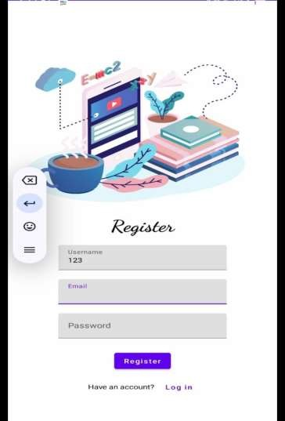
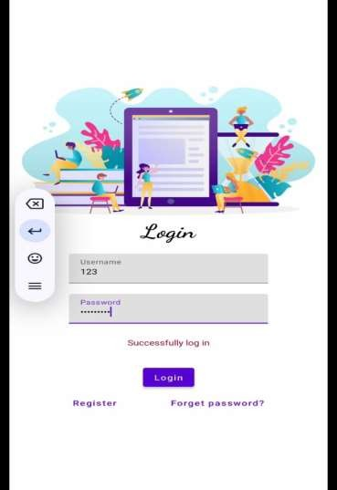
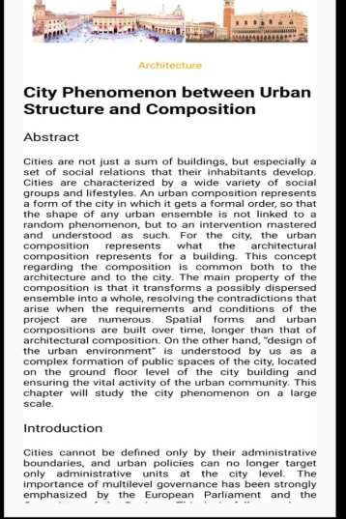
Output screen :
demo link:
https://drive.google.com/file/d/1dnuj4DcOwB-U9hVWrcZi3FZQyvMD4OT0/view?usp=drivesdk

